Slide 1
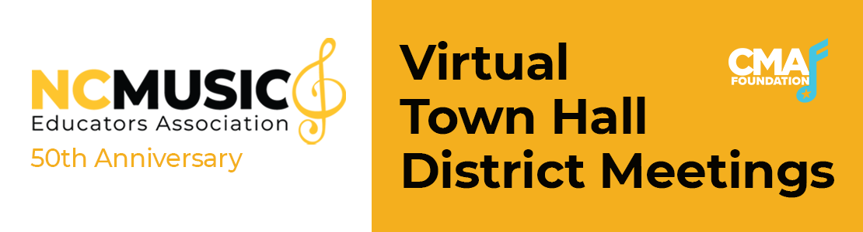

Slide 2
Housekeeping
The session is being recorded and will be available to all participants within a few days.
You will be asked to answer a short survey at the end of the session.
The content being presented in the webinars are to be used as guidance and as a resource. NCMEA does not endorse specific products.
During this time of unprecedented need for virtual/online instructional materials, the first consideration for use must be student safety. To that end, NAfME and NCMEA recommends:
Children under the age to 13, have adult permission before accessing any online resources
Students and/or families do not provide any identifying information to gain access to the resources – free or paid
This webinar has been made possible by the Country Music Association (CMA) Foundation grant.

Slide 3

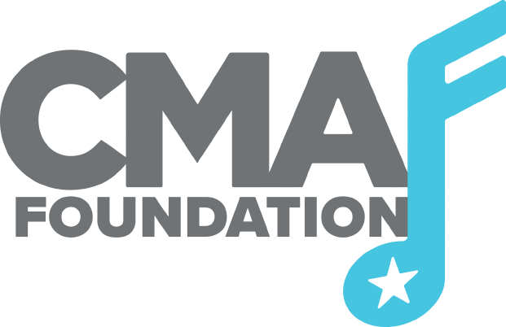
Purpose :
Agenda:
Share state and national resources for music educators to utilize during this school year.
Welcome/Introductions
Resources (State and National) for music educators
How can NCMEA help?
Wrap Up

Slide 4

A message from NCMEA President
Carol Earnhardt
Notes:
The Arts Education Leadership Coalition (AELC) is comprised of the leadership of statewide NC Arts Education Professional Associations in Dance, Music, Theatre Arts, and Visual Arts and Partner Organizations. This coalition has been meeting weekly throughout the summer to provide resources for arts educators.
All of these resources are FREE and open to the public.

Slide 5
Music Educator Resources
(State)
Reopening Recommendations
Created by the NC Arts Education Leadership Coalition (AELC)
Band/Jazz Recommendations
Orchestra Recommendations
Elementary Recommendations
MS & HS Choral Recommendations
NCMEA Advocacy Toolkit
NC Arts High School Graduation Requirement
A student must complete ONE arts credit (music, visual art, theatre arts, dance) between Grade 6 and Grade 12 in order to graduate from high school, beginning with those students entering Grade 6 in 2022.
Notes:
The Arts Education Leadership Coalition (AELC) is comprised of the leadership of statewide NC Arts Education Professional Associations in Dance, Music, Theatre Arts, and Visual Arts and Partner Organizations. This coalition has been meeting weekly throughout the summer to provide resources for arts educators.
All of these resources are FREE and open to the public.

Slide 6
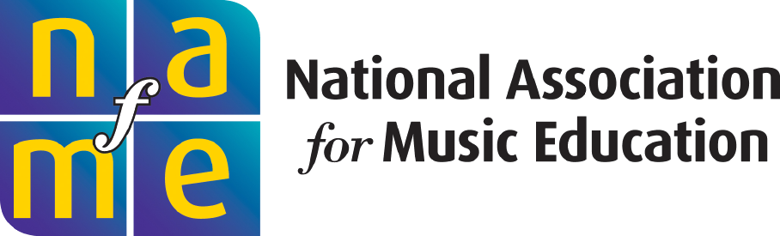

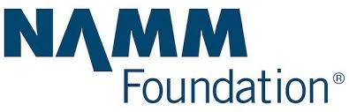
Music Educator Resources
(National)
NAfME COVID-19 Resources
Arts Education is Essential Statement
Online Teaching and Professional Development Webinars
Copyright Guidance
Instrument Cleaning Guidelines and Information

Slide 7
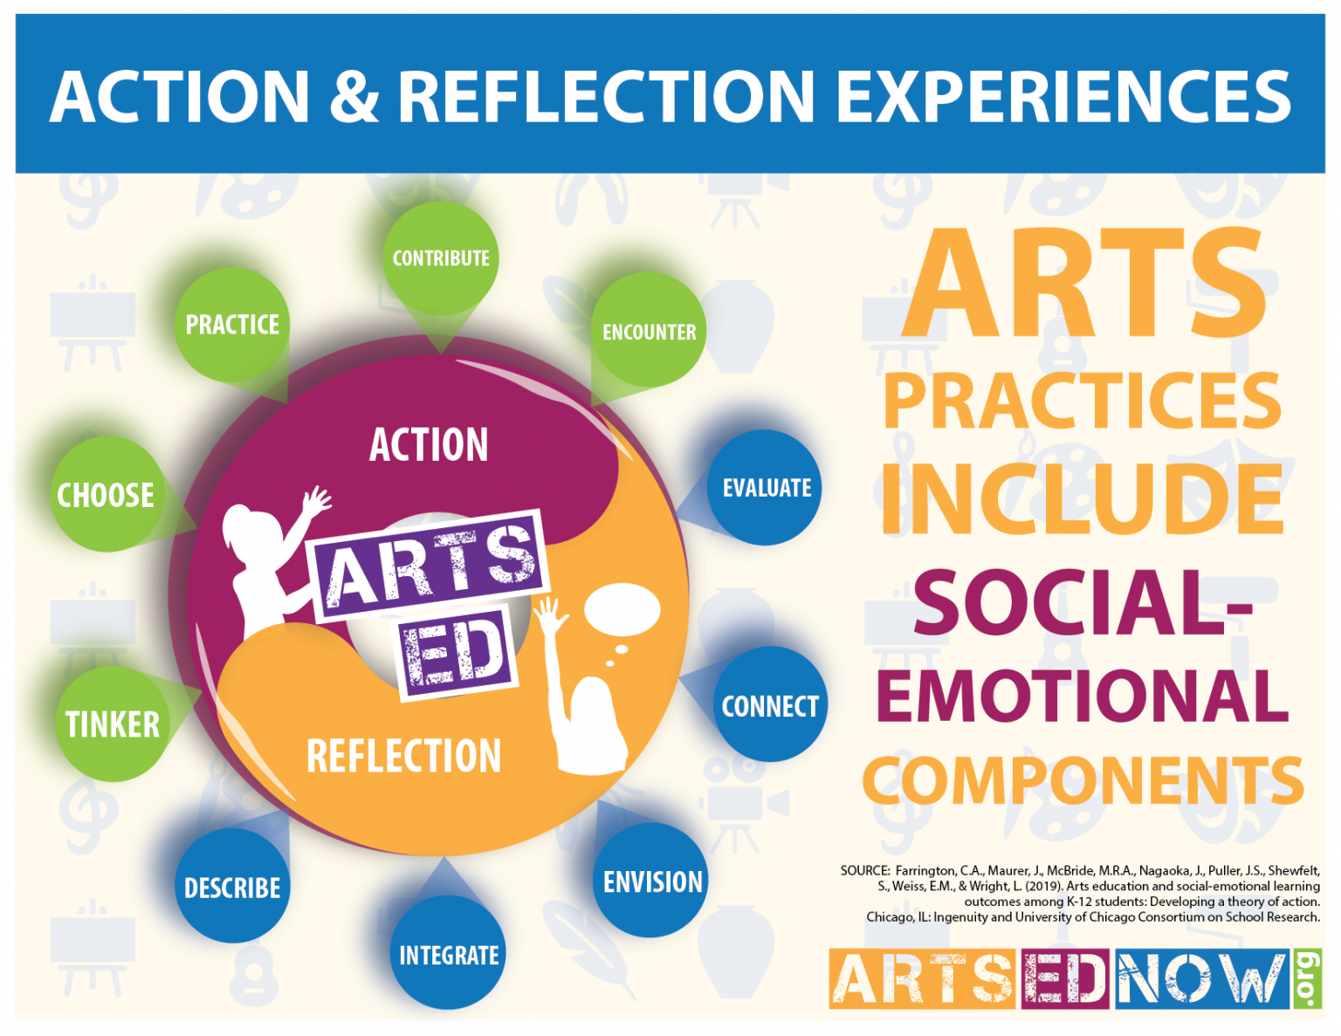
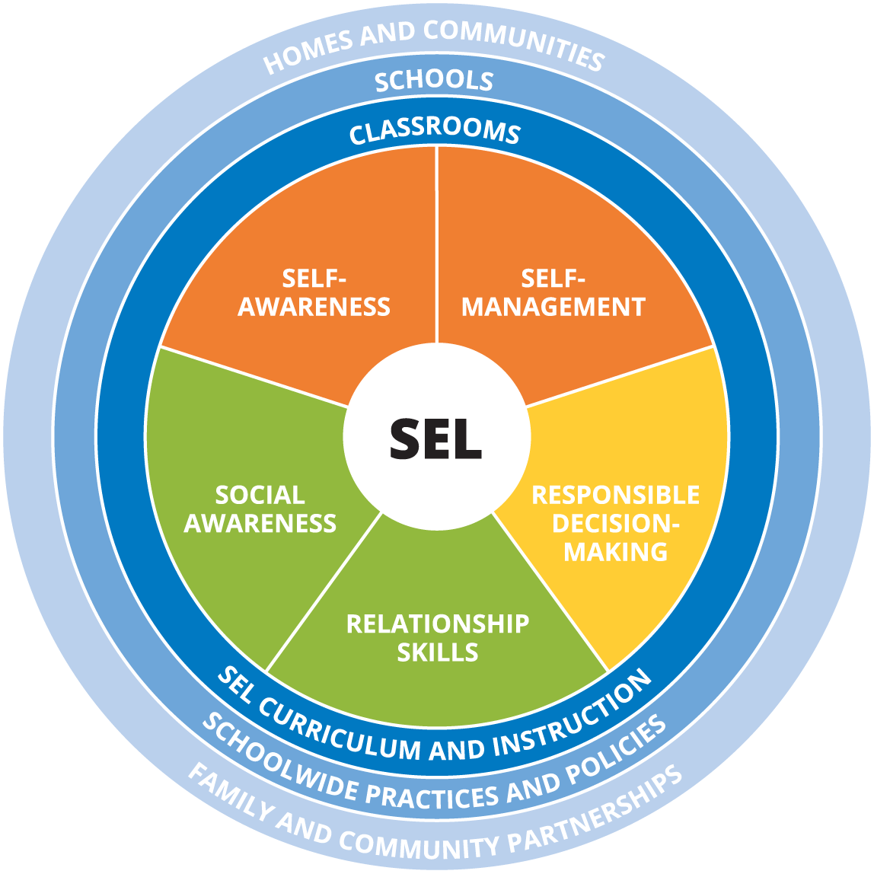
Social and Emotional Learning (SEL)
State Resources for SEL
North Carolina has joined the Collaborative States Initiative through the Collaborative for Academic, Social and Emotional Learning (CASEL)... more information here.
Interactive SEL Wheel
NCDPI SEL webinars
National Resources for SEL
Advocating for Music Education through Social Emotional Learning
NAFME SEL Brochure
Music Education and SEL in the Time of COVID-19 with Scott Edgar webinar
Arts ED NOW Graphics
CASEL 2020
Notes:
North Carolina has joined the Collaborative States Initiative through the Casel Social and Emotional

Slide 8
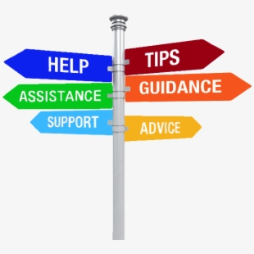
How Can NCMEA Support You?
Share your
success, questions,
or
how NCMEA can support you.

Slide 9
Thank you for coming.
Remember to complete the survey,
Thank you

